Slide 1
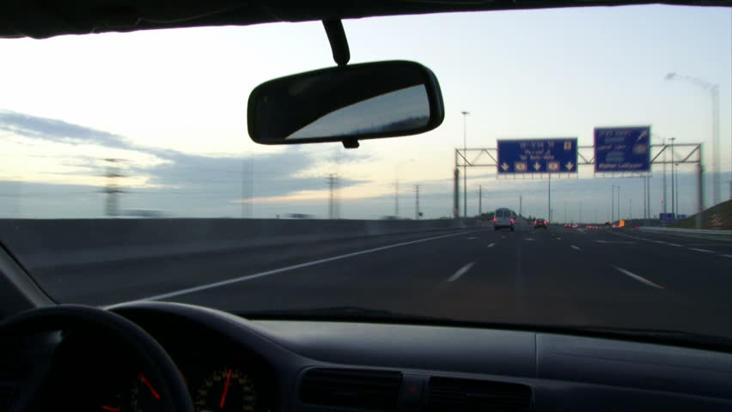

Seeing while moving
Björn Jörges & Laurence R. Harris
Notes:
Heya! Thank you so much for helping us out with our experiment. The idea of this project is to have a look at what happens when we move while we try get an idea of how objects move through the environment.

Slide 2
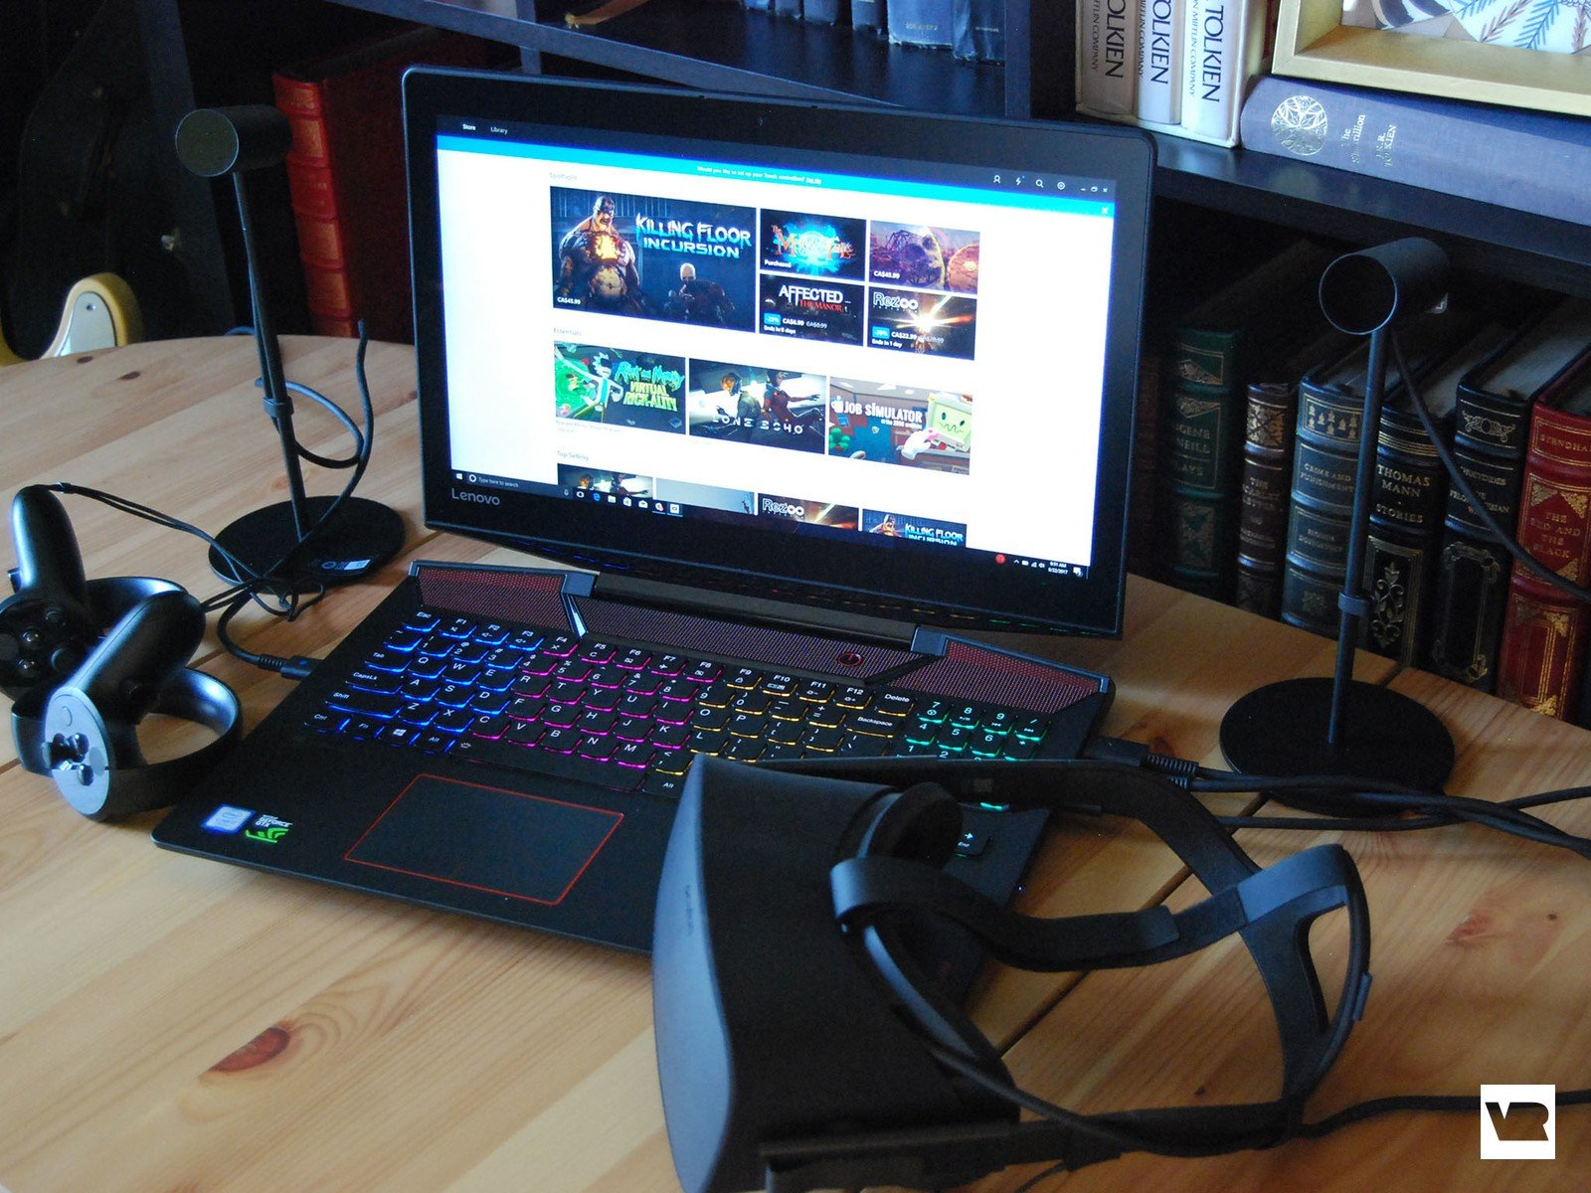

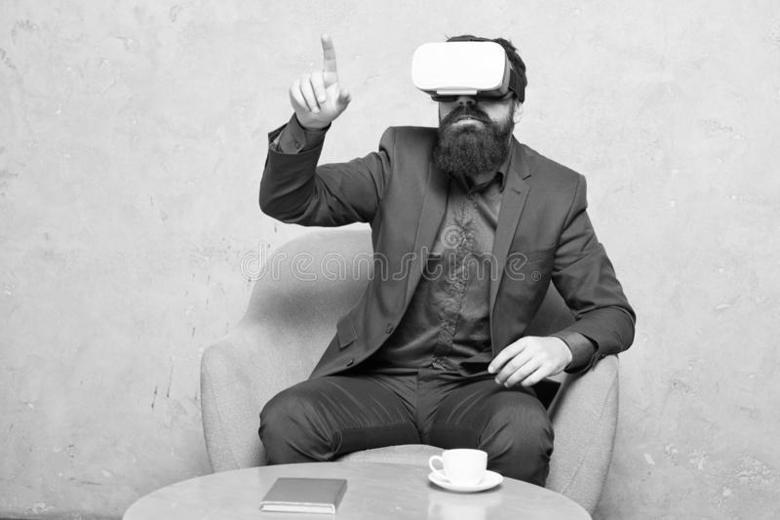
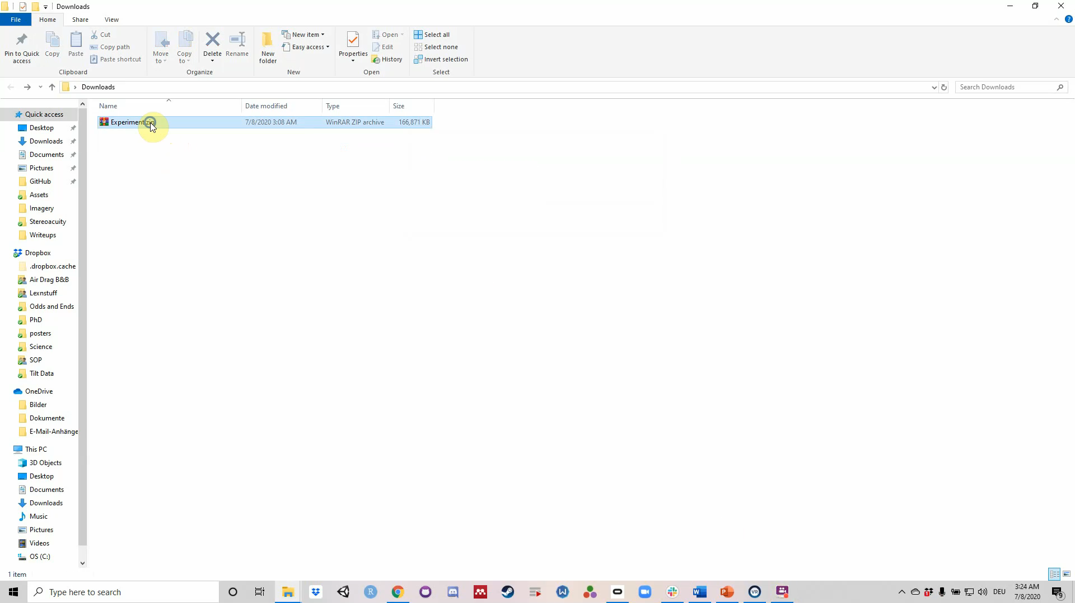
General information
Seat yourself with your Vive device and controllers
Four parts:
A Stereovision Test (2 minutes)
A Training Session (2-4 minutes)
The Main Experiment (50 minutes)
A Short Assessment of Self-Motion Perception (2 minutes)
Fill in and sign the informed consent form!
Notes:
I will start with some general information and then I will explain each of the tasks separately. You will be doing the experiment in VR, you will be seated and you will give responses with your controllers. The experiment consists of four parts: First a stereovision test that takes about 2 minutes, then a training session of 2 to 4 minutes, then the main body of the experiment and finally a short assessment of how you interpret a part of our stimulus. Some general points: If at any point you feel motion sick, please take a break a will, or stop the experiment all together. You can always leave the experiment by pressing ESC on your keyboard. If your Vive is setup for seated or standing play, you can press the side grips on your controllers to recenter the experiment in front of you. If it is set up for play on room scale, you have to orient your chair towards the scene.
Before you start, make sure that you e-sign the informed consent form that we sent you along with the experiment!
To get started, you unzip the package with the experiments you have downloaded, as you can see in the little video on screen right now. Inside, you find one program for each of the four parts of the experiment. The programs are called “Stereotest”, “Training”, “MainExperiment” and “Selfmotion”. Make sure that your Vive is connected and ready to go. Then simply double-click on the respective executable and choose “Start” in the following screen.

Slide 3
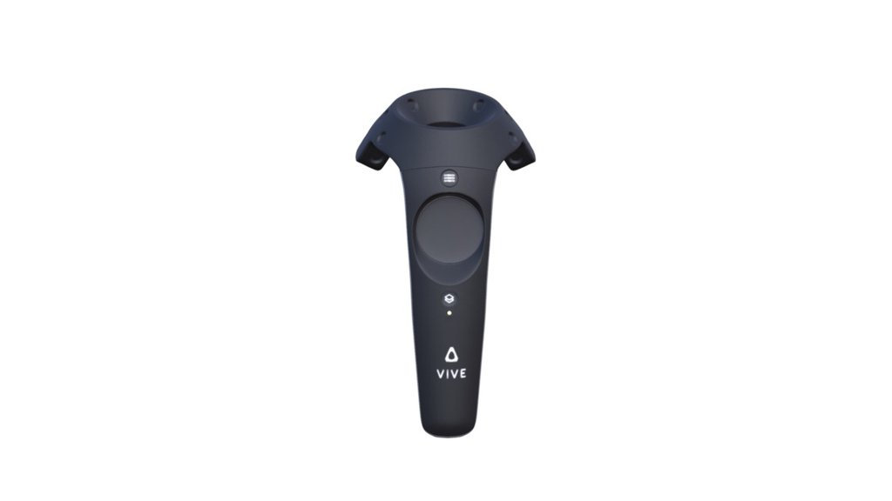

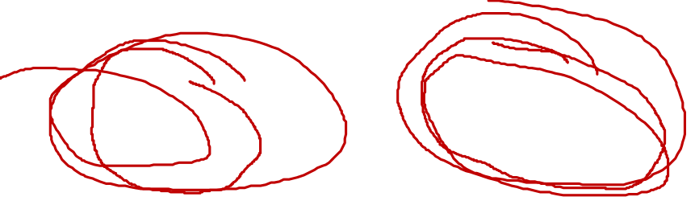
Important: Take your controllers in the correct hand
Icons on controllers in home environment
Notes:
It is very important that you make sure to hold the left controller in the left hand and the right controller in the right hand. You can check that in your home environment. If you look at the 3D models of your controllers in the environment, you should see a hand icon on each controller. Hold the controller with the thumb facing right in your left hand and the controller with the thumb facing left in your right hand.

Slide 4
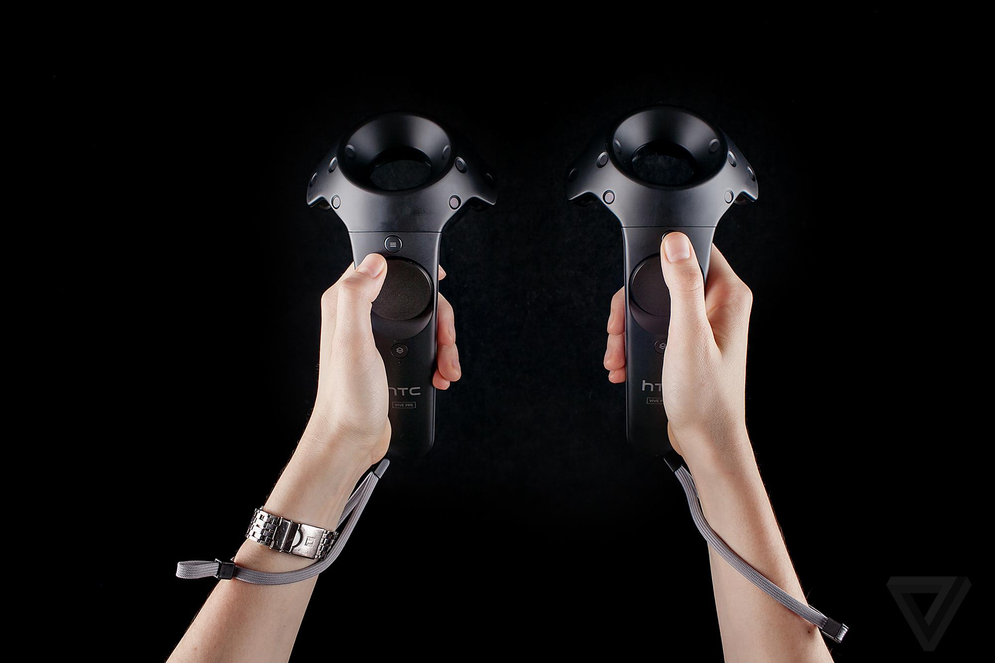
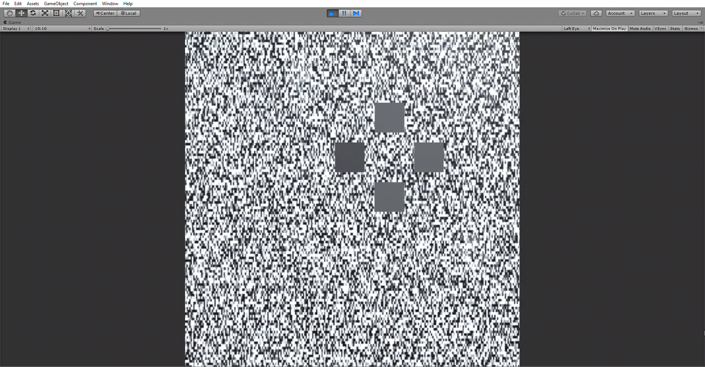
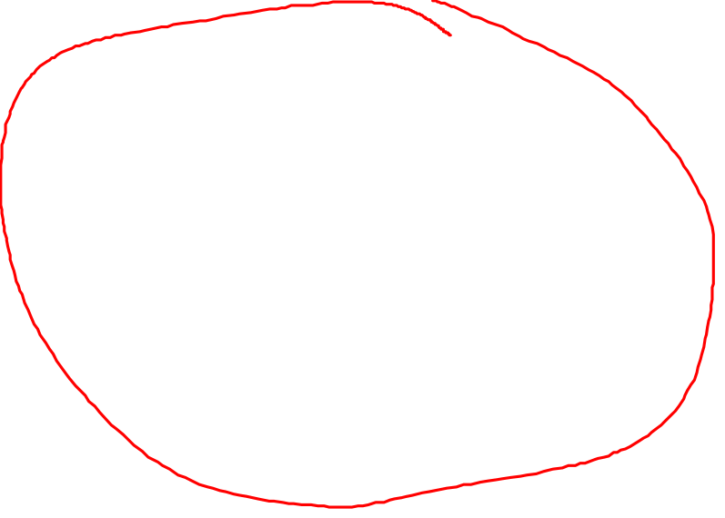
First task: Stereovision Test
How good is your stereoacuity?
Which one pops out?
Use Trackpad to choose and Trigger to confirm and go to next trial
Notes:
Start with the first task, „Stereotest“. Here, we test your stereovision, that is, how well you combine information that come from each of your eyes. You will see four rectangles. One of them should „pop out“ or seem closer to you. You respond by choosing the rectangle that pops out with the trackpad on your controller and pressing the trigger when you are happy with the answer. This takes about two minutes.

Slide 5
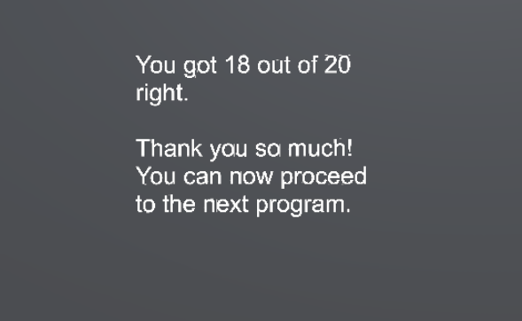
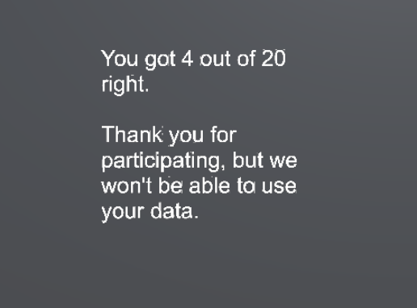
Can we use your data?
Yes! Onwards to Task 2
Unfortunately not – no need to continue
Notes:
At the end, the program will give you feedback on your performance. If you got enough trials right, the program will tell you to continue, as you can see here on the left. If you get the screen on the right, your stereovision might not be good enough to continue. In that case, please send us the data file that is created in the folder with the program and we can still partially compensate you for your effort. Keep in mind that this is NOT an adequate diagnostic tool. If you think you have issues with your stereovision, please talk to your doctor! Now you can close this program by pressing „ESC“ and open the next one, „Training“.

Slide 6
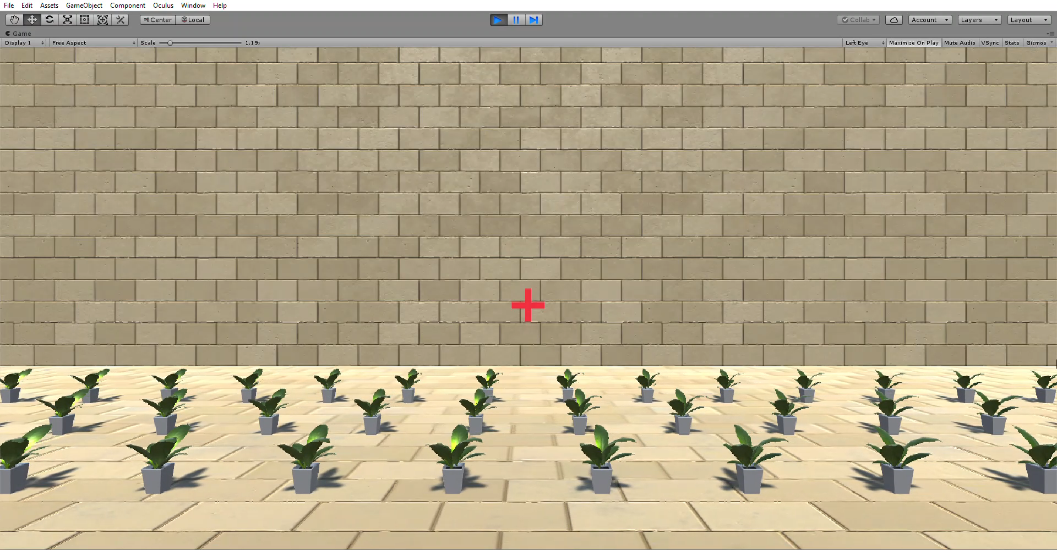
Task 2: Training Session
If the FIRST motion was faster, press the Trigger of the left controller
Which one is faster, the first motion or the second motion?
Press the Trigger of the right controller if the SECOND motion was faster
Notes:
You will be shown this environment here. You will see then two motions, one is a big ball and the other one is a cloud of balls. Your job is to choose which of the two is faster. If the first one is faster, please press the trigger of your LEFT controller. If the second one is faster, please press the trigger of your RIGHT controller. There will also be a reminder of the controls in the beginning of the experiment and after every couple of trials – this is just a reminder and does not mean necessarily that you are doing something wrong! Overall, you will do about 30 comparisons for the training, and please look at the red fixation cross AT ALL TIMES.

Slide 7
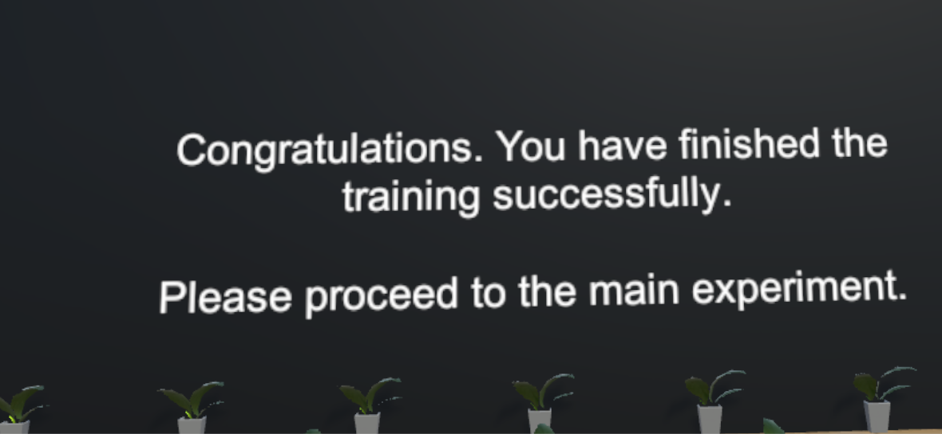
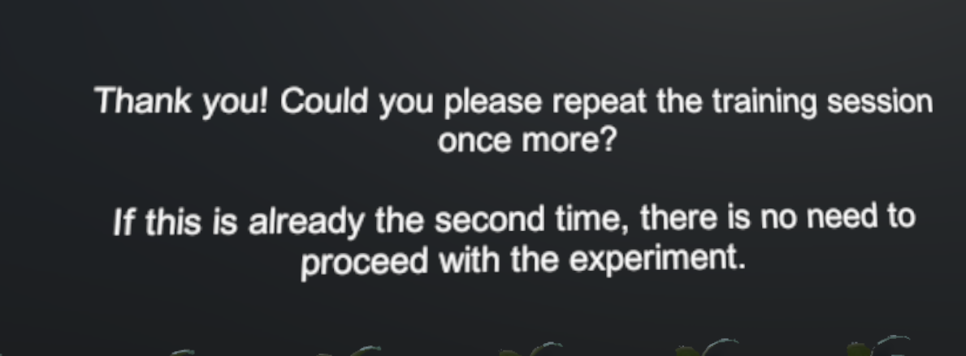
Can we use your data?
Please repeat the training. If you get the same screen the second time around, we won‘t be able to use your data – no need to continue
Yes! Onwards to Task 3
Notes:
At the end of this task, you will see again one of two screens. If you get the screen on the left, everything is perfect and you can just continue on to the next experiment. If you get the screen on the right, we ask you to verify that you got the controls the right way around and do the experiment again. If the second time around you still get the screen on the right, no need to go on. Send us the .txt file that is created in the folder where you found the program and we will compensate you partially for your efforts.

Slide 8
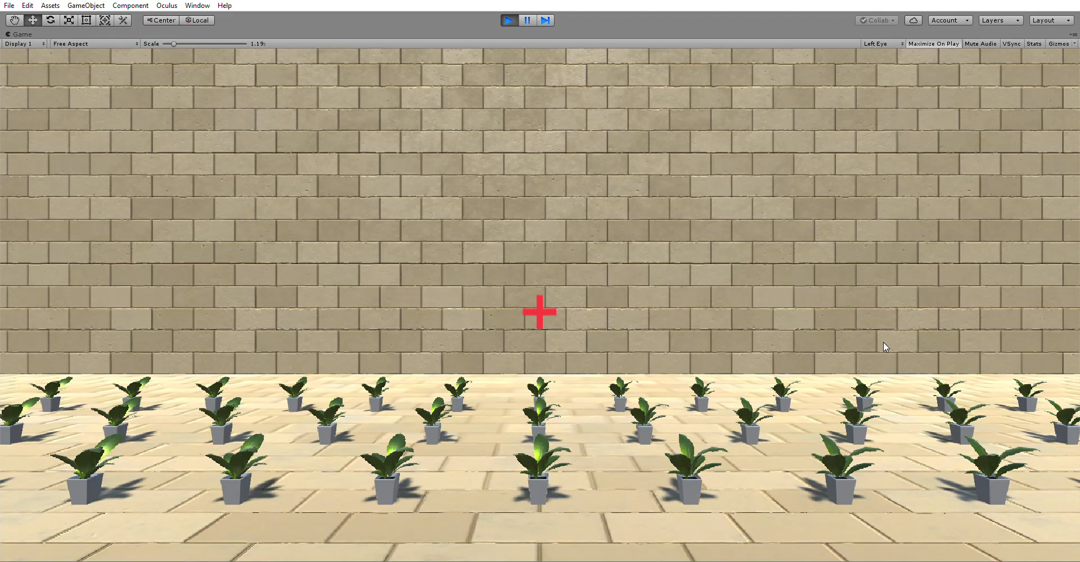
Task 3: Main Experiment
If the FIRST motion was faster, press the Trigger of the left controller
Which one is faster, the first motion or the second motion?
Press the Trigger of the right controller if the SECOND motion was faster
Same as before, but sometimes you move, sometimes the wall moves and sometimes the wall is blank
Notes:
The next program is the main experiment. You have the same task and the same controls as in the training before, but additionally, you are sometimes moved through the scene, and sometimes the wall in the back might go blank. Either way, your task remains the same: Judge which of the two motions is faster. This part of the experiment takes quite long, between 40 and 50 minutes. Be sure to make your decisions based on your first impression. No need think a lot about it! It will seem pretty long to you, but we tested it, and it will terminate in due time. Please take breaks at your own discretion, for example every 15 or 20 minutes. If you want to take a break, just take the headset off at any moment without closing the program, take your break, and when you put it back on, you can just continue with the task. You will get a similar screen as before once you are finished, but there is no criterion anymore at this stage. Remember to keep looking at the red fixation cross!

Slide 9
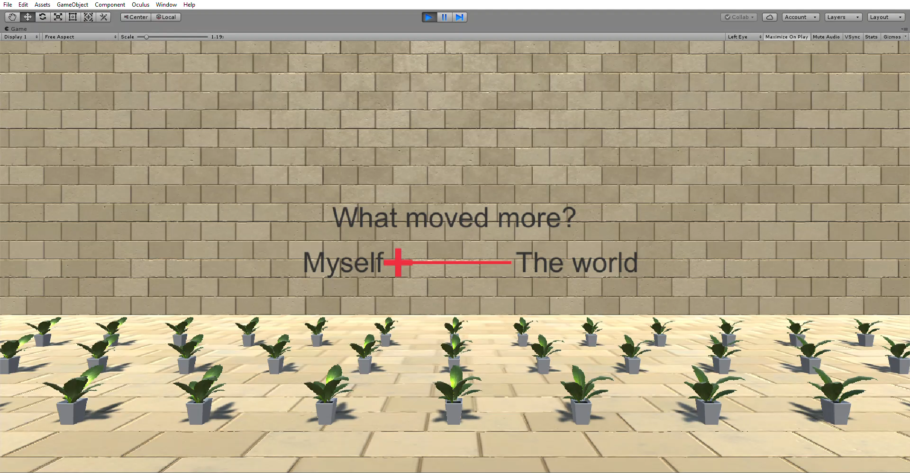
Task 4: Self-Motion Assessment
What moved more? You? The world? The wall?
Use Trackpad to move the slider and Trigger to confirm and go to next trial
Notes:
As last step, open the fourth program „Selfmotion“. Here, you judge what youre perceive to move in the experiment. Depending on the condition, you have two out of three options: you moved, the whole world moved or the wall moved. You give your response by adjusting the position of the fixation cross with the trackpad. So if you thought that only you were moving, put the fixation cross all the way to the left. If you had a mixed sensation that both you moved and world, then you put it somewhere in the middle between both. When you‘re happy with your answer, you press the trigger and move on to the next trial. Important, look closely at the red fixation cross while the motion happens. While you are adjusting the cross on the sliding scale, you can look around.

Slide 10
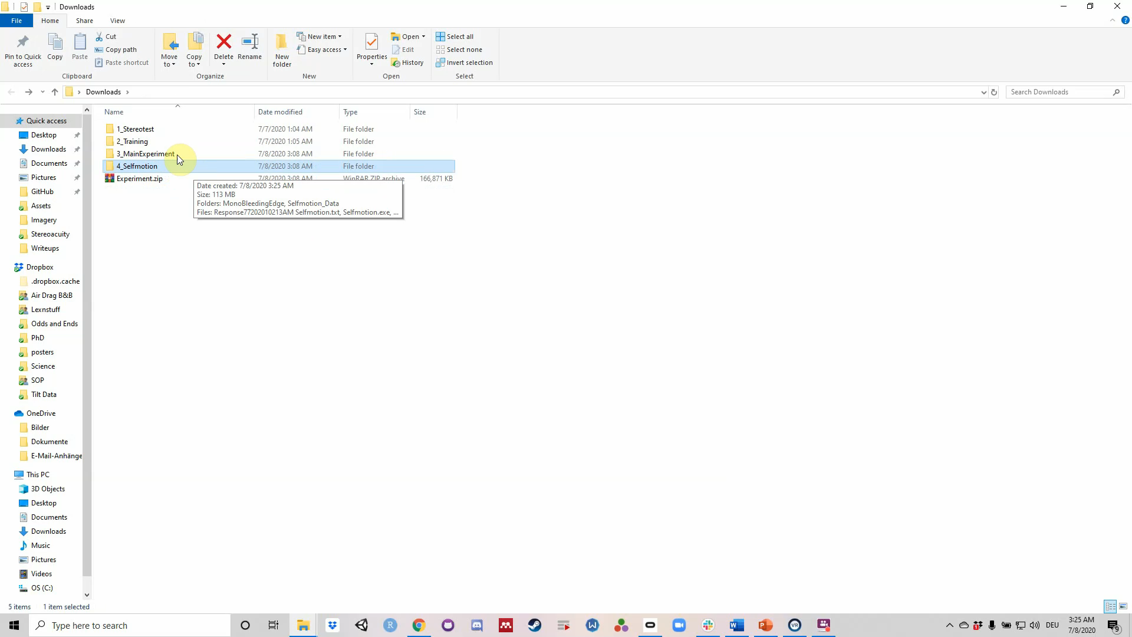
Wrap-up
Look for the data files for all four experiments: .txt files in the folders with the .exe files
„... Stereotest.txt“
„... Training.txt“
„... MainExperiment.txt“
„... Selfmotion.txt“
Send files to us, make sure you sent the informed consent form
Notes:
Finally, to wrap everything up, we need you to send the txt files with the data from your experimental sessions. There is one data file for each part of the experiment and theyre all located in the corresponding folders. Once we receive your data file and verify that your informed consent form is signed, we will issue the Amazon giftcard. Once the whole project is done, we will send you a debrief with the results. Thank you so much for helping us out!

